Slide 1
Affordable HOUSING partnerships
In the Diocese of Victoria
A Partnership with
St. Vincent de Paul, other qualified non-profits, BC Builds,
and the Roman Catholic Diocese of Victoria
OCTOBER 2, 2024

Slide 2
Who are we HOUSING?
(focus on ‘not for profit’ housing)
The 20%+ of our citizens who benefit from ‘not for profit’ housing or very low rent housing.
Median income singles, seniors and families who will never be able to afford to rent or own a single detached house. They benefit from renting or owning small scale multi-unit housing. Or missing middle housing.

Slide 3
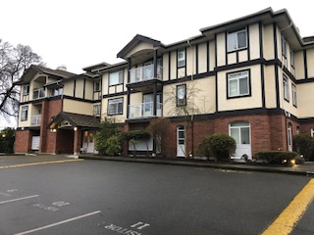
Affordable housing definition
Mixed income housing includes:
  market rent housing
  rent geared to income housing
  deeply discounted and subsidized rent housing
St. Clare’s Villa, St. Patrick’s Parish Victoria

Slide 4
WHAT IS AFFORDABILITY ?
There is no perfect policy or housing proposal that fits all sizes. Let’s not allow perfect to vanquish the good.
WHILE NOT EVERY HOUSE IS AFFORDABLE FOR EVERYONE, EVERY HOUSE IS AFFORDABLE FOR SOMEONE.

Slide 5
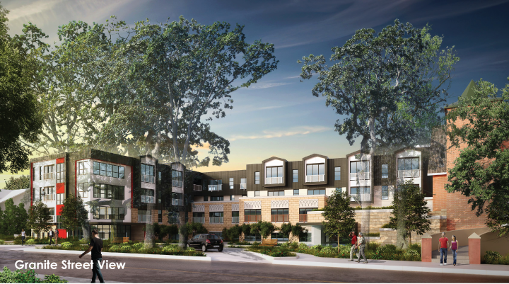
Opportunity in 2024: we HAVE COME A LONG WAY!
In 2024 we have local governments approving affordable housing proposals faster and easier than in 2015
We have expedited approval processes that give preference to affordable housing proposals
And we have BC Housing and BC Builds inviting churches & church-affiliated non-profit organizations to partner with them to design, build, own, and operate affordable housing

Slide 6
just say yes!
We appeal to clergy to reuse, repurpose and redevelop church lands. To work with your communities to sustain, retain and build congregation. And to help with housing for those in need
We are not asking clergy & parishes to do it
We are asking clergy & parishes to allow it to be done
It will be done through a PARTNERSHIP with BC Builds, St. Vincent de Paul and other qualified non-profits, and the Roman Catholic Diocese of Victoria

Slide 7
Call to action
Meet with your community and parishioners and have a conversation.
Shall we make available our surplus church lands for ‘not for profit’ housing, Catholic health care, preschools / daycares, or something else?
Shall we ask the Diocese to facilitate a Feasibility Study?
THANKS!

