Slide 1


WELCOME

Slide 2

Welcome and Introduction
Welcome
Facilitator introduction
Territorial acknowledgement
Introductions
Opening prayer
Notes:
Welcome everyone and Introduce self
2. Lead territorial acknowledgement (adjust for the part of the diocese you are presenting in) We acknowledge and respect the Lekwungen-speaking Peoples on whose traditional territories we gather today and the Songhees, Esquimalt and WSANEC peoples whose historical relationships with the land continue to this day.
3. Have everyone introduce themselves
4. Move to opening prayer

Slide 3

Opening Prayer
Leader:
Lord Jesus, you said where two or three come together in your name, you are there with them. And so, we begin our time together,
All: … in the name of the Father, Son and the Holy Spirit.

Slide 4
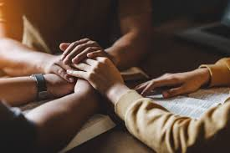
Opening Prayer
All:
Lord God, We ask for your blessing on us today. Be a source of inspiration to us as we gather. To this end we pray,
Our Father……
Amen.
Notes:
Our Father, Who art in heaven, Hallowed be Thy Name.
Thy Kingdom come, Thy Will be done, On earth as it is in Heaven.
Give us this day, our daily bread, And forgive us our trespasses, as we forgive those who trespass against us.
And lead us not into temptation, but deliver us from evil.
Amen

Slide 5
What is Horizons of Hope?
Horizons of Hope: A Toolkit for Catholic Parishes on Palliative Care was developed by the Canadian Conference of Catholic Bishops. It seeks to:
Empower and educate parishioners by addressing questions surrounding palliative care, dying, passing on the eternal life, suffering, accompaniment, and bereavement in a holistic fashion.
Present high-quality content that explores how palliative care is understood from a perspective of Catholic moral and pastoral theology, medical expertise and the Compassionate Community model.
Facilitate meaningful conversations together so that our parishes and families become Compassionate Communities, grounded in the mercy and tenderness of the living Christ.
Notes:
Let people read on their own
The diocese created a video that Bishop Gary would like people to watch as an introduction to the course

Slide 6
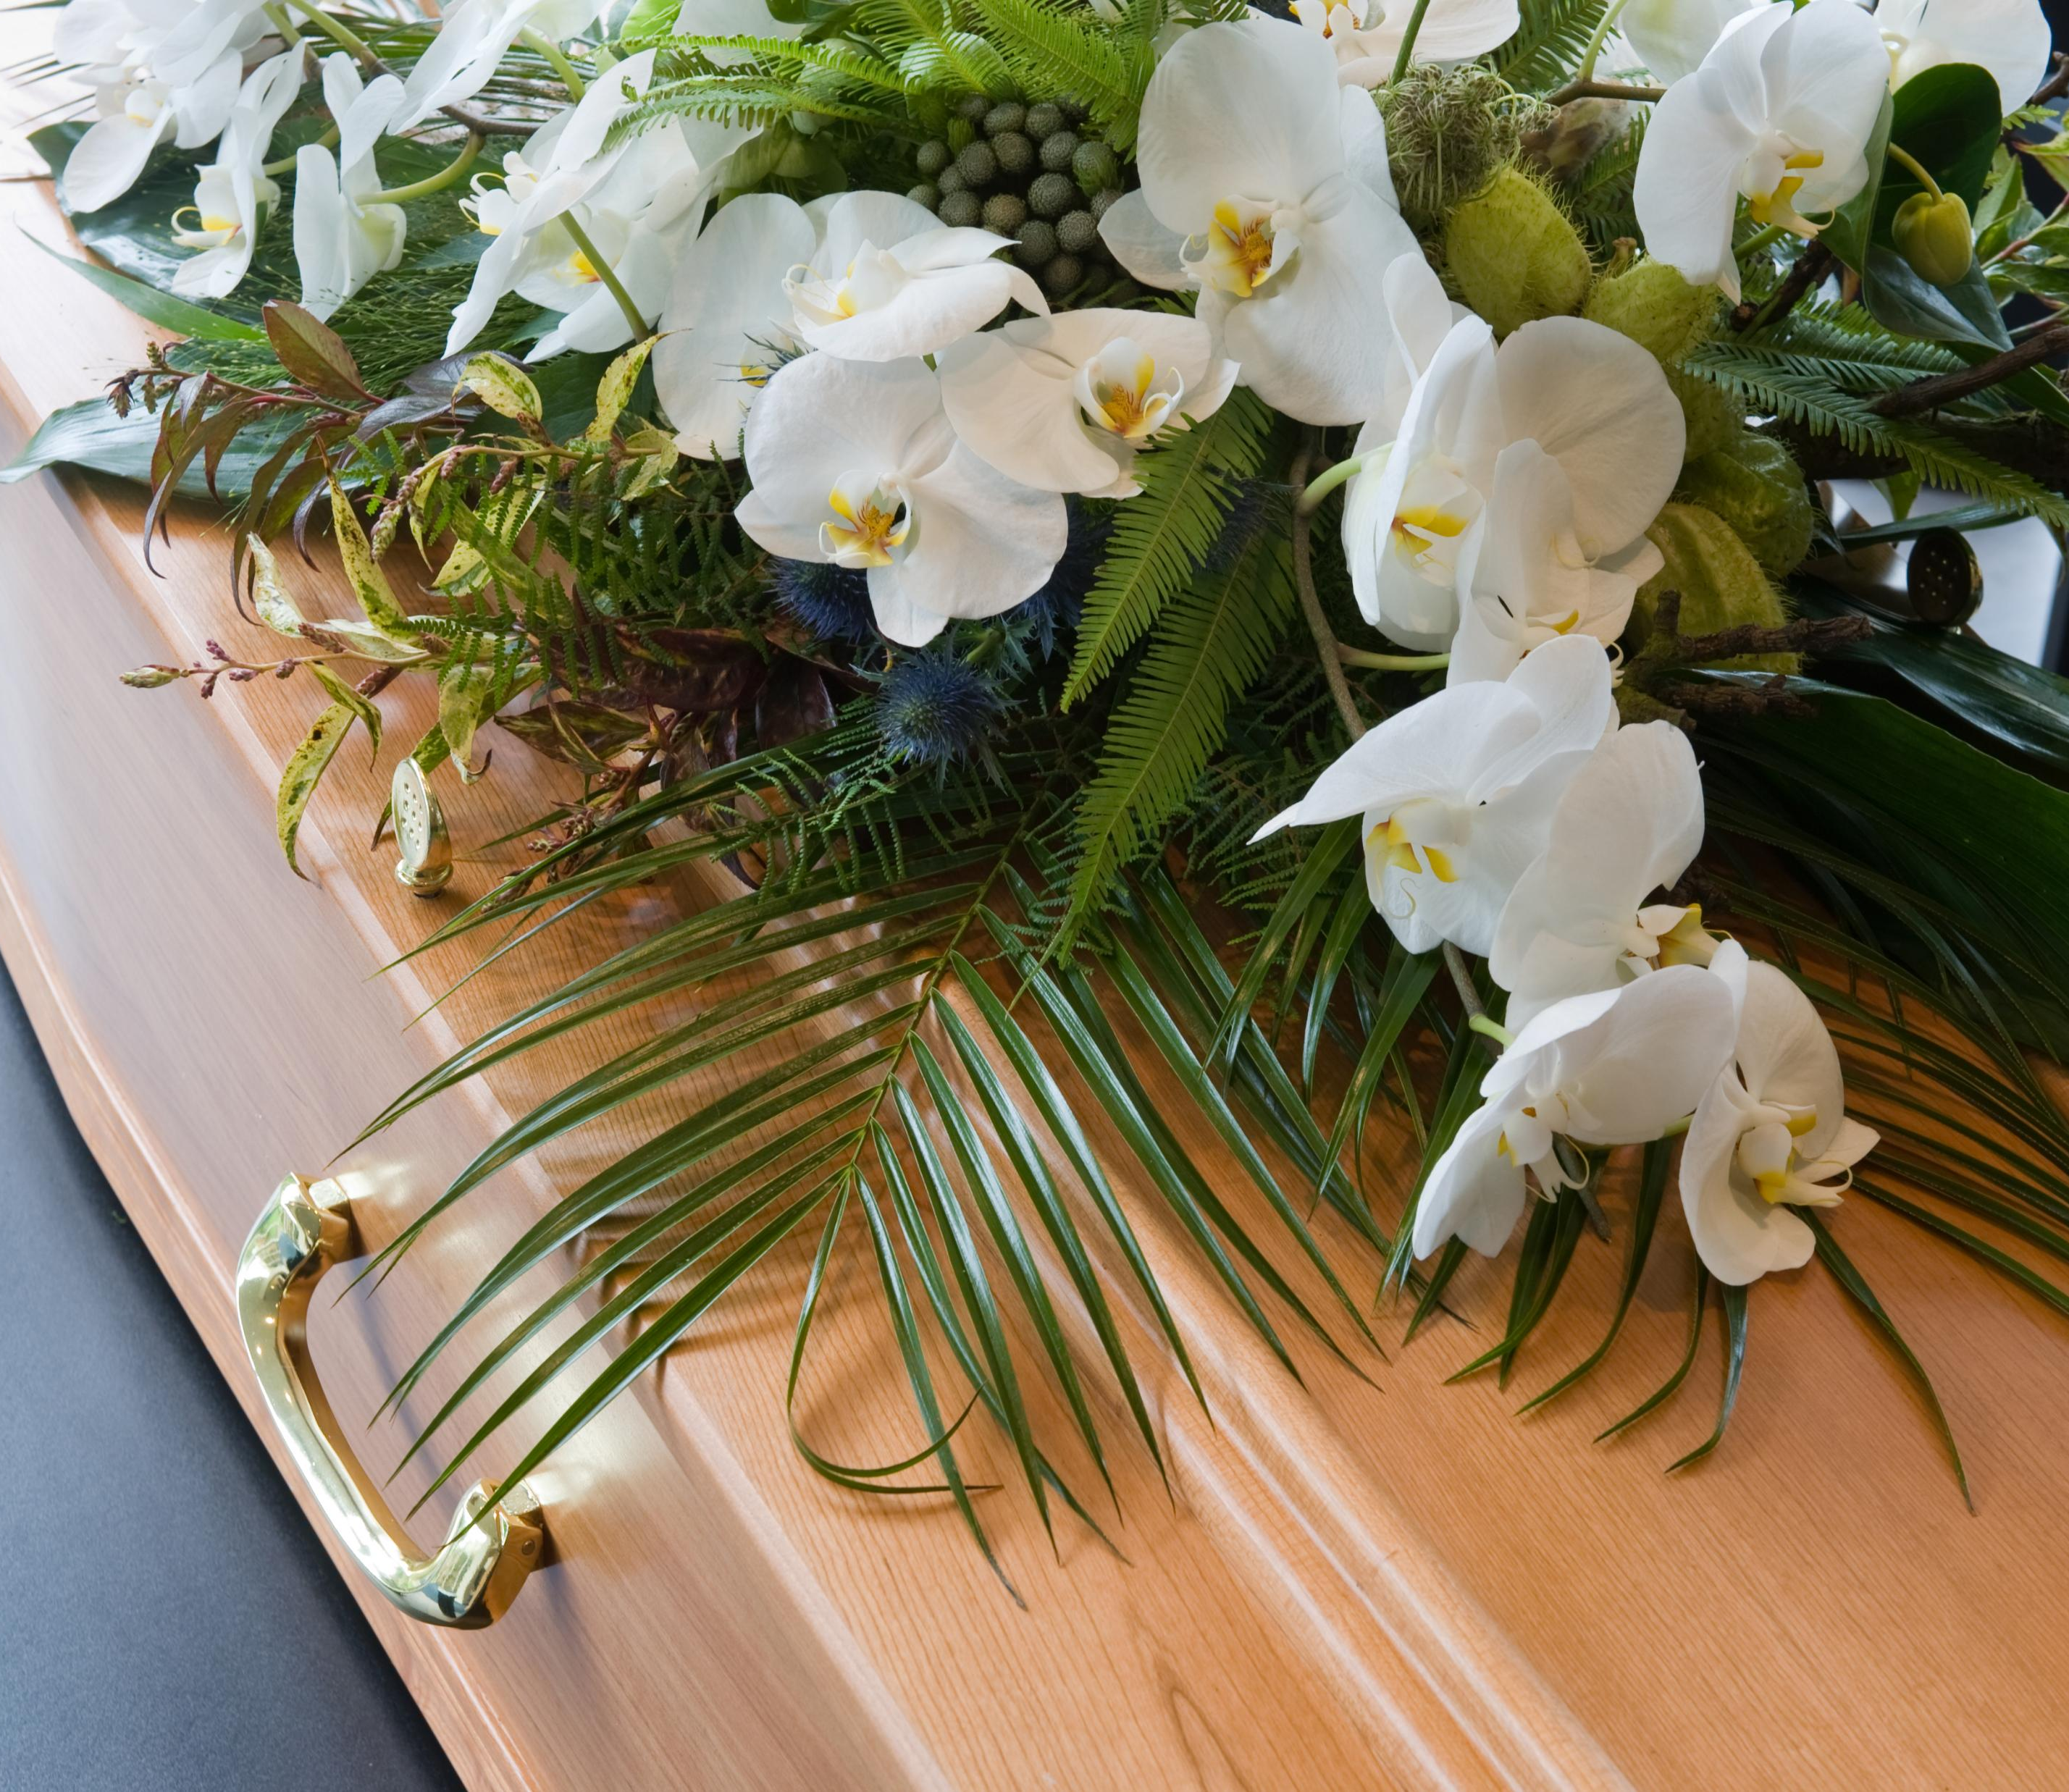
“Passing on to Eternal Life” versus “End of Life”
Horizons of Hope: A Toolkit developed some years ago by the Canadian Conference of Catholic Bishops uses the term “End of Life” throughout the toolkit.
Bishop Gary’s wish is that we avoid using the term “End of Life” and instead focus on the term of “Passing on to Eternal Life”.
For God so loved the world that he gave his one and only Son, that whoever believes in him shall not perish but have eternal life. (John 3:16)
Notes:
Death is not the end, only the end of our earthly bodies.
Life is transitional .. From the womb to the world… from the world to eternal life.
John 11:25-26
"Jesus said to her, 'I am the resurrection and the life. Those who believe in me, even though they die, will live, and everyone who lives and believes in me will never die.’ ”
John 5:24
"I tell you the truth, whoever hears my word and believes him who sent me has eternal life and will not be condemned; he has crossed over from death to life."
John 11:25-26 - Jesus said to her, “I am the resurrection and the life. Whoever believes in me, though he die, yet shall he live, and everyone who lives and believes in me shall never die.

Slide 7

Diocesan Video - Introduction

Slide 8

The Course: 4 Modules/Sessions according the CCCB Toolkit
Module 1: (today) Understanding the Human Experience of Dying and Death (and passing onto Eternal Life)
Module 2: Discerning and Making Decisions at the End of Life (as we prepare to pass on to Eternal Life)
Module3: Accompanying Those at the End of Life (as they pass on to Eternal Life)
Module 4: Supporting and Integrating within the Wider Community
Notes:
NOTE: brackets in module is Bishop’s preferred wording
The course includes 4 sessions (once a week for 4 weeks – or could be twice a week for 2 weeks)
Today we will work through model one.

Slide 9

Agenda for Each Day
Part 1: Experience
Preparing our Hearts
Proclamation of the Word
Guided Personal Reflection
Table Conversation
Large Group Focus
Part 2: New Information (X2 with break in between)
Video
Application to My Life
Small Group Conversation
Large Group Focus
Part 3: Action
Going Forth
Notes:
For those that want to know how the day will unfold

Slide 10

Listening Circles – Norms for Conversation
Small groups (3-4 people)
All participants will be given an opportunity to speak in the group; some may choose not to.
One person speaks at a time.
Each person can choose to share as they see fit.
Please don’t interrupt someone when they are speaking; just listen and respect what the person has to say
Allow everyone to speak before you speak again
Participants, if they choose, may respond to the speaker in a helpful but non-judgmental/non-confrontational way.
Respect each other and commit to confidentiality to promote trust.
Notes:
There will be time for small groups and large group discussion.
In the small group we will follow a listening circle format – please keep this in mind when we speak

Slide 11
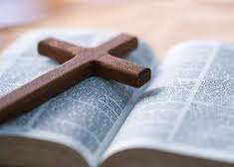
Part 1: Experience
Preparing our Hearts
Proclamation of the Word: Luke 7:11-13 Soon afterwards he went to a town called Nain, and his disciples and a large crowd went with him. As he approached the gate of the town, a man who had died was being carried out. He was his mother’s only son, and she was a widow; and with her was a large crowd from the town. When the Lord saw her, he had compassion for her and said to her, “Do not weep.”
Notes:
So the first part begins with a scripture passage to start with to set the tone for the learning that will take place
Turn to page 26 – focus questions.
Take 3-4 minutes to reflect on your own on those questions, then we will share in small groups

Slide 12
Reflection
Guiding questions:
How would the widow have been helped by the presence of a supportive and compassionate community during this time of grief?
Where do you find hope in this passage?
personal – table – large group
Notes:
Turn to page 26 – focus questions.
Take 3-4 minutes to reflect on your own on those questions, then we will share in small groups
Reflect on the reading – what word, phrase or image from the Gospel struck you or reminded you or spoke to you your lived experience
Small group – 5 minutes – feel free to share anything that you reflected on and that you might want to share with others
Large groups – 3 minutes – bring to close identifying one or two things that was shared during the table discussion

Slide 13
Part 2A – New Information
Video:
A Theological Perspective
(theological and ethical reflection on the experience of death, dying, and passing on the eternal life)
Notes:
This video (about 6 minutes) will introduce you to two important concepts:
A Christian perspective of life
A Christian perspective of death

Slide 14

Reflection
Guiding questions:
What messages were confirmed for me about the Christian perspectives on life and death?
What was new for me?
What do I still want to know?
How can I relate this new information to past experiences?
personal – table – large group
Notes:
Turn to page 30 – focus questions.
Video script is on pages 27-29
Take 10 minutes to reflect on your own on those questions, then we will share in small groups
Small group – 15-20 minutes – feel free to share anything that you reflected on from the guiding questions
Large groups – 5 minutes – bring to close identifying one or two things that was shared during the table discussion

Slide 15

Break
Notes:
5-10 minutes

Slide 16

Part 2B – New Information
Video:
A Medical Perspective
Notes:
The video (7 minutes) introduces you to medical questions about palliative care
How do people die
What is palliative care
Illness trajectory (rapid or prolonged decline)
Withdrawal and withholding treatment

Slide 17

Reflection
Guiding questions:
Were you surprised by anything that was said or shown in the video?
How do you feel about palliative care now?
personal – table – large group
Notes:
Turn to page 39 – focus questions.
Video script is on pages 31-34
Illness trajectory is pages 35-38
Take 5-7 minutes to reflect on your own on those questions, then we will share in small groups
Small group – 10-15 minutes – feel free to share anything that you reflected on from the guiding questions
Large groups – 5 minutes – bring to close identifying one or two things that was shared during the table discussion

Slide 18

Part 3: Action
Going Forth – Further personal reflection you may want to do at home
Handouts, and
Appendix 7

Slide 19

Wrap-up
Thank you
Next session: Discerning and Making Decisions at the End of Life (as we prepare to pass on to Eternal Life)

Slide 20

Diocesan Invitation
It is an invitation from Bishop Gary to consider taking the Pastoral Care Training as it is a good supplement to the Horizons of Hope Training sessions.
It is a free 9-module online diocesan training that takes place every fall and winter, open to anyone who is personally drawn to the healing ministry of Christ
Through the training, you will learn:
Why the healing ministry of Christ is important
What is meant by the ministry of presence and accompaniment
Ways to improve your skills in active and compassionate listening
How to get involved in your parish’s pastoral care ministry
The ways a visit can have a positive impact on someone’s health.
If you can only attend a few sessions - recommendation is Sessions 2, 3 and 8.
Notes:
You may have received or will be receiving a letter from Bishop Gary with further details on this.

Slide 21

Closing Prayer
All:
May today there be peace within each of us.
May we trust that you have placed us exactly where we are meant to be.
May we not forget the infinite possibilities that are born of faith in You.
May we use the gifts we have received and pass on to others your love that has been given to us.
May we be content with ourselves just the way we are.
Let this knowledge settle in our bones and allow our soul the freedom to sing, dance, praise and love.
Amen.
(St. Therese’s Prayer: St. Therese of Lisieux, the Little Flower)

