Slide 1


WELCOME
(module 3)

Slide 2

Welcome and Introduction
Welcome to session 3
Accompanying Those
at the End of Life (as they pass on to Eternal Life)
Reflection on last session
Opening prayer
Notes:
1. Welcome everyone
2. Have everyone restate their name and share a one or two sentence reflection from the last session (something they liked or something they learned or…)
4. Move to opening prayer (next slide)

Slide 3

Opening Prayer
All: … in the name of the Father, Son and the Holy Spirit.
Side 1:
Gracious God,
thank you for the gift of today.
Side 2:
Refresh us. Invite us to discover your presence in each person that we meet
and every event that we encounter.
Side 1:
Teach us when to speak and when to listen,
when to ponder and when to share.
Notes:
Determine which side of the room is side 1 and which is side 2

Slide 4

Side 2:
In moments of challenge and decision
attune our hearts to the whisperings of your Wisdom.
Side 1:
As we undertake ordinary and unnoticed tasks throughout our day,
gift us with simple joy.
Side 2:
When our day goes well, may we rejoice.
When it grows difficult, surprise us with new possibilities.
All:
When life is overwhelming, call us to Sabbath moments
to restore your Peace and Harmony.
May our living today reveal your goodness. Amen.
(adapted from Morning Prayer by Pat Bergen, C.S.J.)

Slide 5

The Course:
4 Modules/Sessions according the CCCB Toolkit
  Module 1:
  Understanding the Human Experience of Dying and Death (and passing onto Eternal Life)
  Module 2:
  Discerning and Making Decisions at the End of Life (as we prepare to pass on to Eternal Life)
  Module 3: (today)
  Accompanying Those at the End of Life (as they pass on to Eternal Life)
  Module 4:
  Supporting and Integrating within the Wider Community
Notes:
As you know, the course includes 4 sessions (Tues and Thurs – 2 weeks)
Today we will work through module three.

Slide 6

Agenda for the Day
Part 1: Experience
  Preparing our Hearts
  Proclamation of the Word
  Guided Personal Reflection
  Table Conversation
  Large Group Focus
Part 2: New Information (X2 with break in between)
  Video
  Application to My Life
  Small Group Conversation
  Large Group Focus
Part 3: Action
  Going Forth
Notes:
A reminder to know how the day will unfold

Slide 7

Listening Circles –
Norms for Conversation
Small groups (3-4 people)
Everyone has a chance to speak; some may choose not to.
One person to speak at a time. Others to listen and don’t interrupt.
Allow everyone to speak before you speak again
Each person can choose to share as they see fit. Respect what the person has to say
Participants, if they choose, may respond to the speaker in a helpful but non-judgmental/non-confrontational way.
Respect each other and commit to confidentiality to promote trust.
Notes:
Reminder - There will be time for small groups and large group discussion.
In the small group we will follow a listening circle format – please keep this in mind when we speak the norms of conversation are:
(stress not interrupting others when they are speaking
and letting everyone speak once before you speak again)

Slide 8
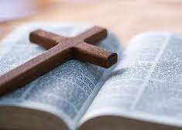
Part 1: Experience
Preparing our Hearts
Proclamation of the Word:
John 19: 25-27
Near the cross of Jesus stood his mother and his mother's sister, Mary the wife of Clopas, and Mary of Magdala. Seeing his mother and the disciple whom he loved standing near her, Jesus said to his mother, 'Woman, this is your son.’ Then to the disciple he said, 'This is your mother.' And from that hour the disciple took her into his home.
Notes:
As Christians, we look to the Gospel to guide us, inspire us and help us to grow in our relationship with Jesus. When we reflect on the Gospel stories, they help us understand the experiences we are going through in our lives. Let us quiet ourselves to hear the Word of God.
So we prepare our hearts today with a scripture passage to start with to set the tone for the learning that will take place
Turn to page 24 – focus questions.
Take 3-4 minutes to reflect on your own on those questions, then we will share in small groups

Slide 9
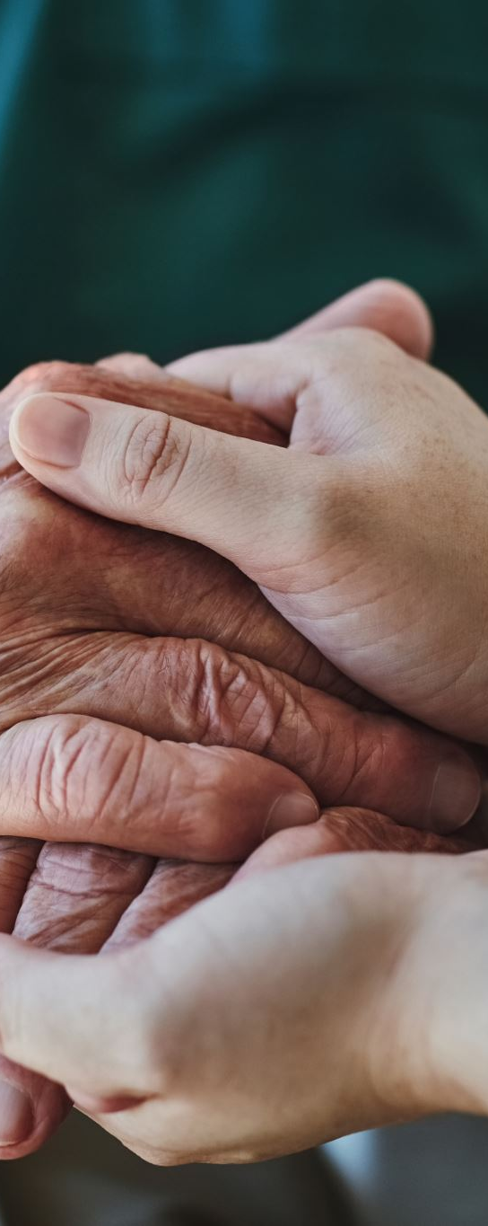
Reflection
Guiding questions:
John 19:25–27 depicts a very poignant moment between Jesus and his Mother Mary. She had accompanied him and been present at the most significant times in his life up to and including his crucifixion. Now Jesus, out of his deep love for Mary, his Mother, places her into the care of John: it is here that she becomes known as Mother of the Church. What feelings or emotions surface for you as you consider this passage?
Describe a time when someone you were accompanying reached out to accompany you.
Does this scripture help you to see that even in the most painful of times we are not alone, but rather we are surrounded by a community that loves and cares for us?
personal- small group - large group
Notes:
Turn to page 24 – focus questions.

Slide 10

Part 2A – New Information
Video:
Theological and ethical perspective
on accompanying those at the end of life (as they pass on to eternal life)
Notes:
This video will introduce you to the topics of:
supporting the sick and the dying,
using Jesus as a model for accompanying others,
and how to accompany well.

Slide 11

Reflection
Guiding questions:
What messages were confirmed for me about the Christian perspectives on accompanying at the end of life (as one passes on the eternal life)?
What was new for me?
What do I still want to know?
How can I relate this new information to past experiences?
personal – small group – large group
Notes:
Video script is on pages 25-27
You now have an opportunity to consider the theological/ethical content of the video.
Turn to page 28 – focus questions.
Take 6 minutes to reflect on your own on those questions, then we will share in small groups
Small group – 15 minutes – feel free to share anything that you reflected on from the guiding questions
Large groups – 5 minutes – bring to close identifying one or two things that was shared during the table discussion

Slide 12

Break
Notes:
5-10 minutes

Slide 13

Part 2B – New Information
Video:
Medical perspective
on accompanying those at the end of life (as they pass on to ternal life)
Notes:
This video will introduce you to medical questions about palliative care.
Topics to be explored include:
the process and signs of dying;
planning how to respond when death is imminent or has happened, especially in a home setting.

Slide 14

Reflection
Guiding questions:
Are you comforted in knowing that your loved one will be able to pass on peacefully and without pain with good palliative care?
How does understanding the process of death help you when you are accompanying someone as they are dying and passing on to eternal life?
Why is it important to have a plan prepared for the time when passing on to eternal life comes? Who will you call to avoid a crisis?
personal – small group – large group
Notes:
Video script is on pages 29-31
Let’s reflect upon what you have heard about the process and signs of dying and death in the video we have just watched. Here are some questions to help us reflect on this:
Turn to page 32 – focus questions.
Take 6 minutes to reflect on your own on those questions, then we will share in small groups
Small group – 15 minutes – feel free to share anything that you reflected on from the guiding questions
Large groups – 5 minutes – bring to close identifying one or two things that was shared during the table discussion

Slide 15

Part 3: Action
Going Forth – Further personal reflection you may want to do at home
Appendix 6
Notes:
An important part of the learning cycle is the Action component because it allows you to take the new knowledge you have reflected on and applied during the session into your daily lives.
(pages 33-38)
Quickly walk people through the pages

Slide 16

Wrap-up
Thank you
Next session:
Supporting and Integrating within the Wider Community

Slide 17

Closing Prayer
Leader:
2 Corinthians 1:3-4
Blessed be the God and Father of our Lord Jesus Christ, the Father of mercies and God of all comfort, who comforts us in all our affliction, so that we may be able to comfort those who are in any affliction, with the comfort with which we ourselves are comforted by God.
All:
God, help those approaching the end of their earthly lives and passing on to eternal life to discover your peace. May they receive and feel your comfort and the comfort of others. Help them to be at rest knowing they are loved. Calm their soul and may they spend eternity with you. Bless their families and friends and bring them comfort and peace.
And Lord, guide and help us to accompany and comfort others in their time of need. Amen

