Slide 1

Diocese of Victoria Pilot Program
for Preparation for the Sacraments:
Signs of Grace
Joelle Dressler
Director of Faith Formation and Evangelization
Diocese of Victoria
Priest’s Council
Update April 2025
Joelle Dressler
Director of Faith Formation and Evangelization
Diocese of Victoria

Slide 2
Background

Slide 3
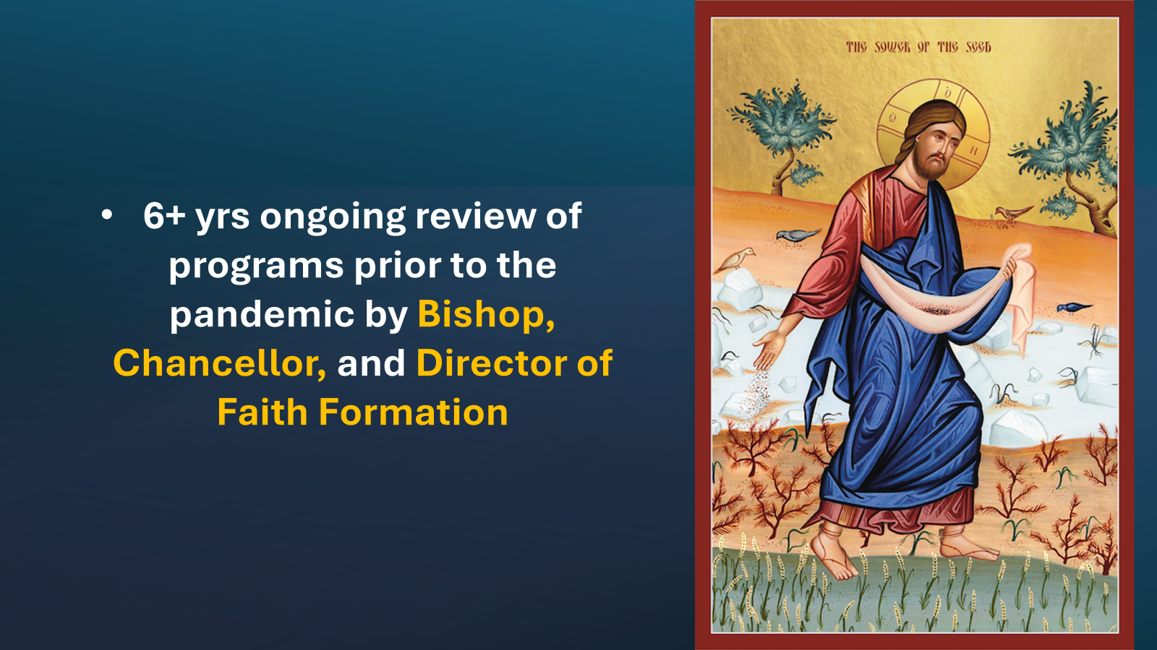

Slide 4
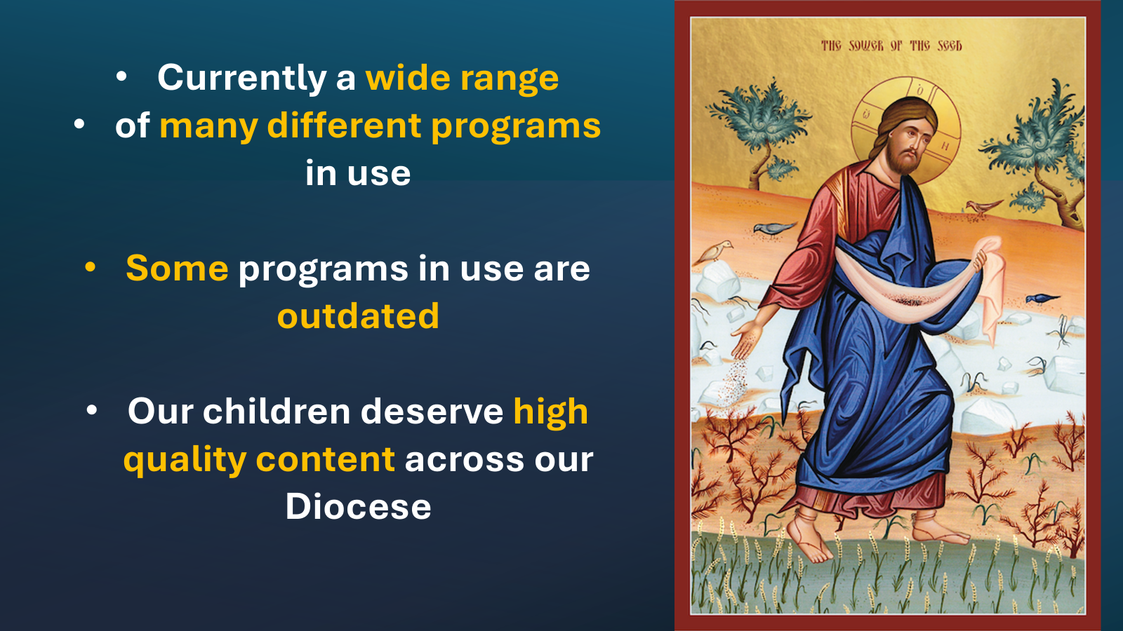

Slide 5
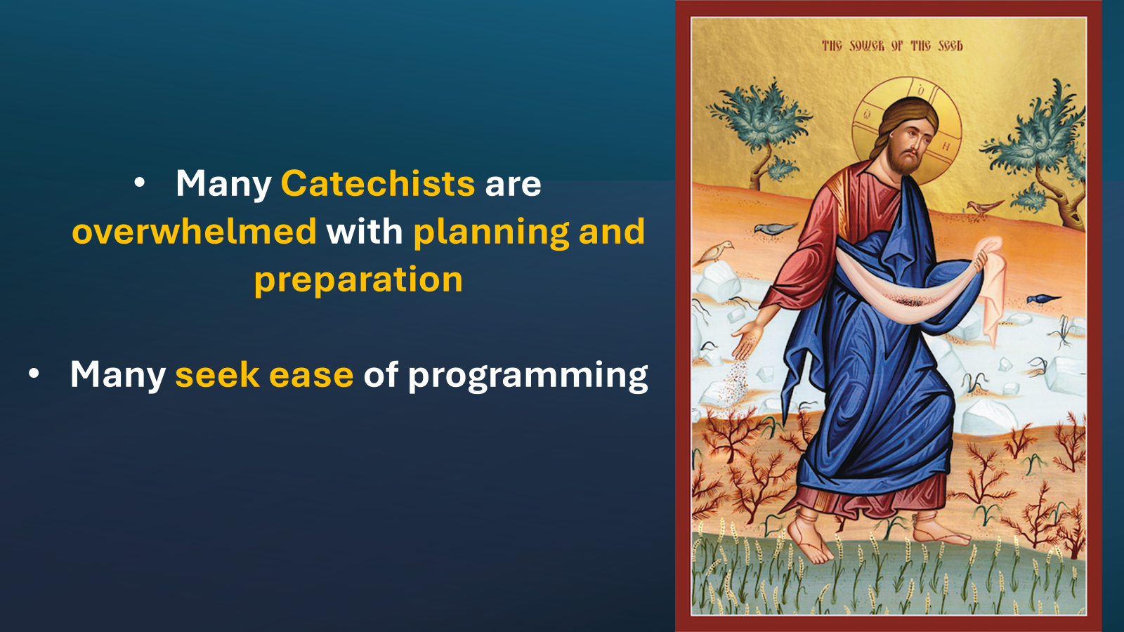

Slide 6
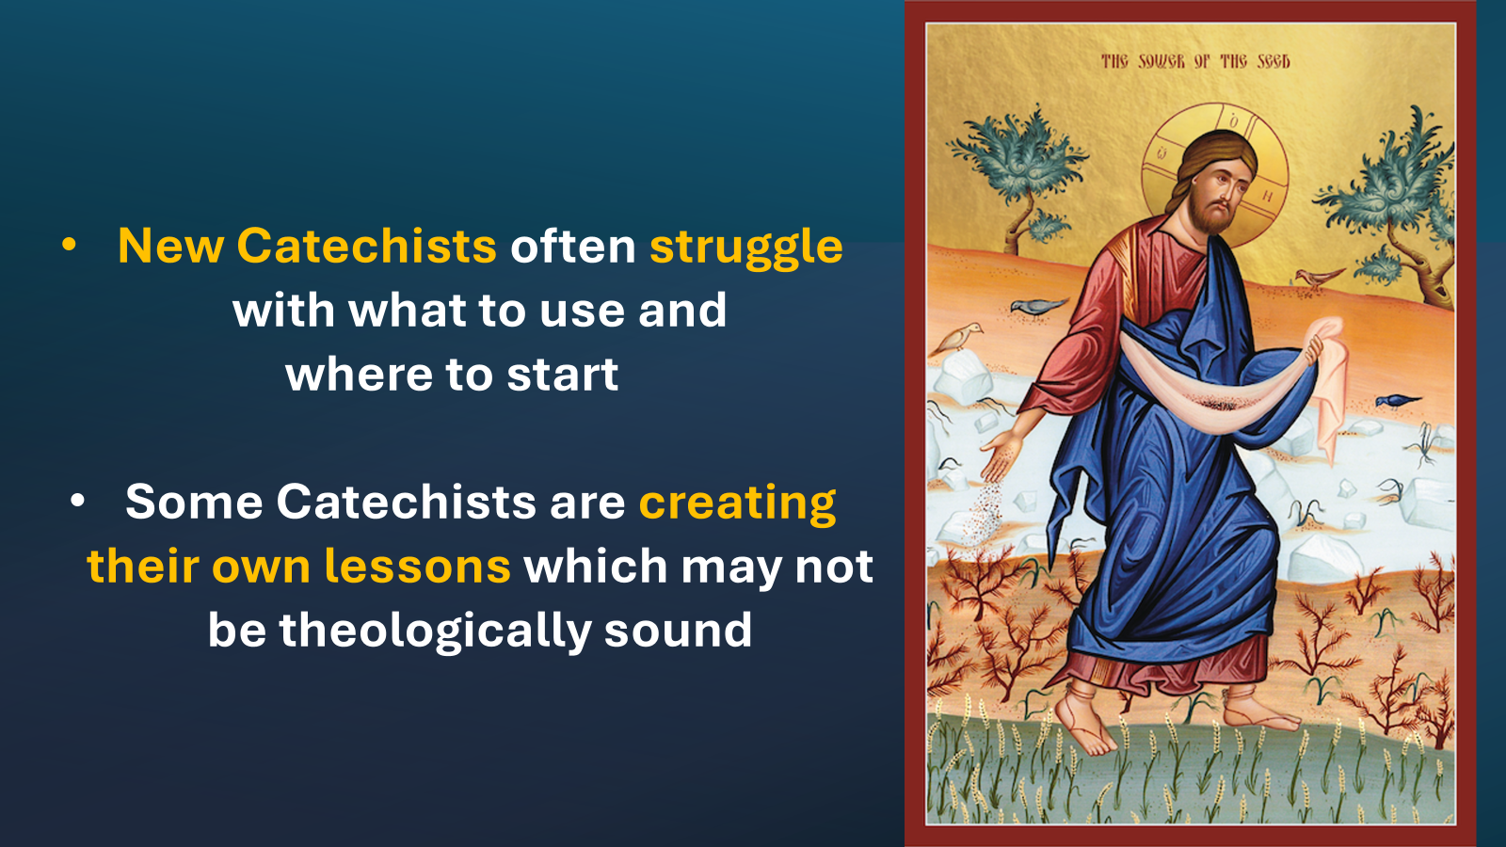

Slide 7
The Augustine Institute

Slide 8
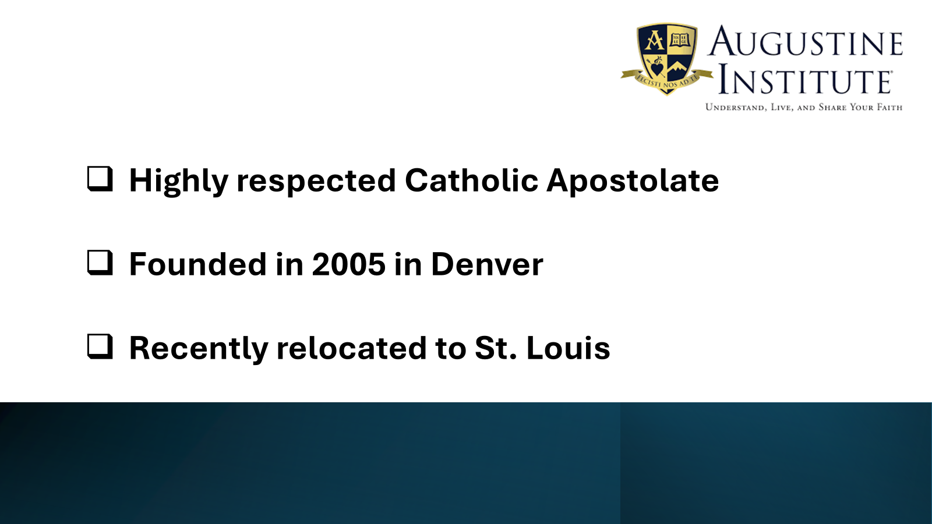
Signs of Grace comes from the Augustine Institute:

Slide 9


Slide 10



Slide 11




Slide 12
Survey Parameters

Slide 13
11 Parishes SOG Pilot Project 2024-25
Holy Trinity | Our Lady of the Rosary | St. Joseph the Worker
Holy Family/ St. Francis of Assisi | St. Bonaventure | St. Peter’s (2022-23)
Our Lady of Fatima | St. Elizabeth’s | St. Rose of Lima
St. Francis Xavier

Slide 14
Pilot Project Data Collection
✅ 21 Catechists
✅ In 11 Parishes
Total number of parishes currently offering preparation for the sacraments = 23
One half of parishes participated in the pilot project

Slide 15
100% Feedback Provided by 21/21 Catechists
Holy Trinity 1 catechist | Our Lady of the Rosary 1 catechist | St. Joseph the Worker 4 catechists
Holy Family/ St. Francis of Assisi 1 catechist | St. Bonaventure 1 parent as catechist | St. Peter’s (2022-23) 1 catechist
Our Lady of Fatima 8 catechists | St. Elizabeth’s 2 catechists | St. Rose of Lima 1 catechist
 | St. Francis Xavier 1 catechist

Slide 16
Pilot Project Data Collected from 21 Catechists
✅ Lead Catechists
✅ Catechists
✅ Parents as Catechists
✅ Catechists in an online setting
✅ Catechists using Spanish program
Catechist experience ranges from
8 months to 16 years

Slide 17
Summary of Data Graphs
From Catechists’ Google Survey

Slide 18
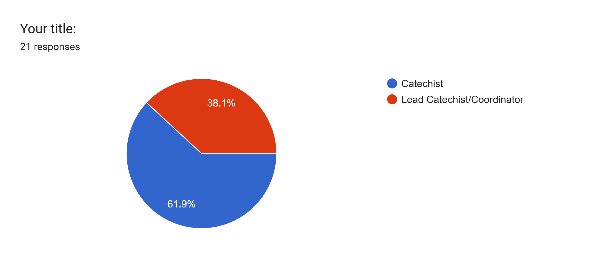
Titles of Catechists completing the feedback survey

Slide 19
The following graphs show each catechist’s rating on a 5 point scale, with 1 being the lowest and
5 being the highest rating:

Slide 20
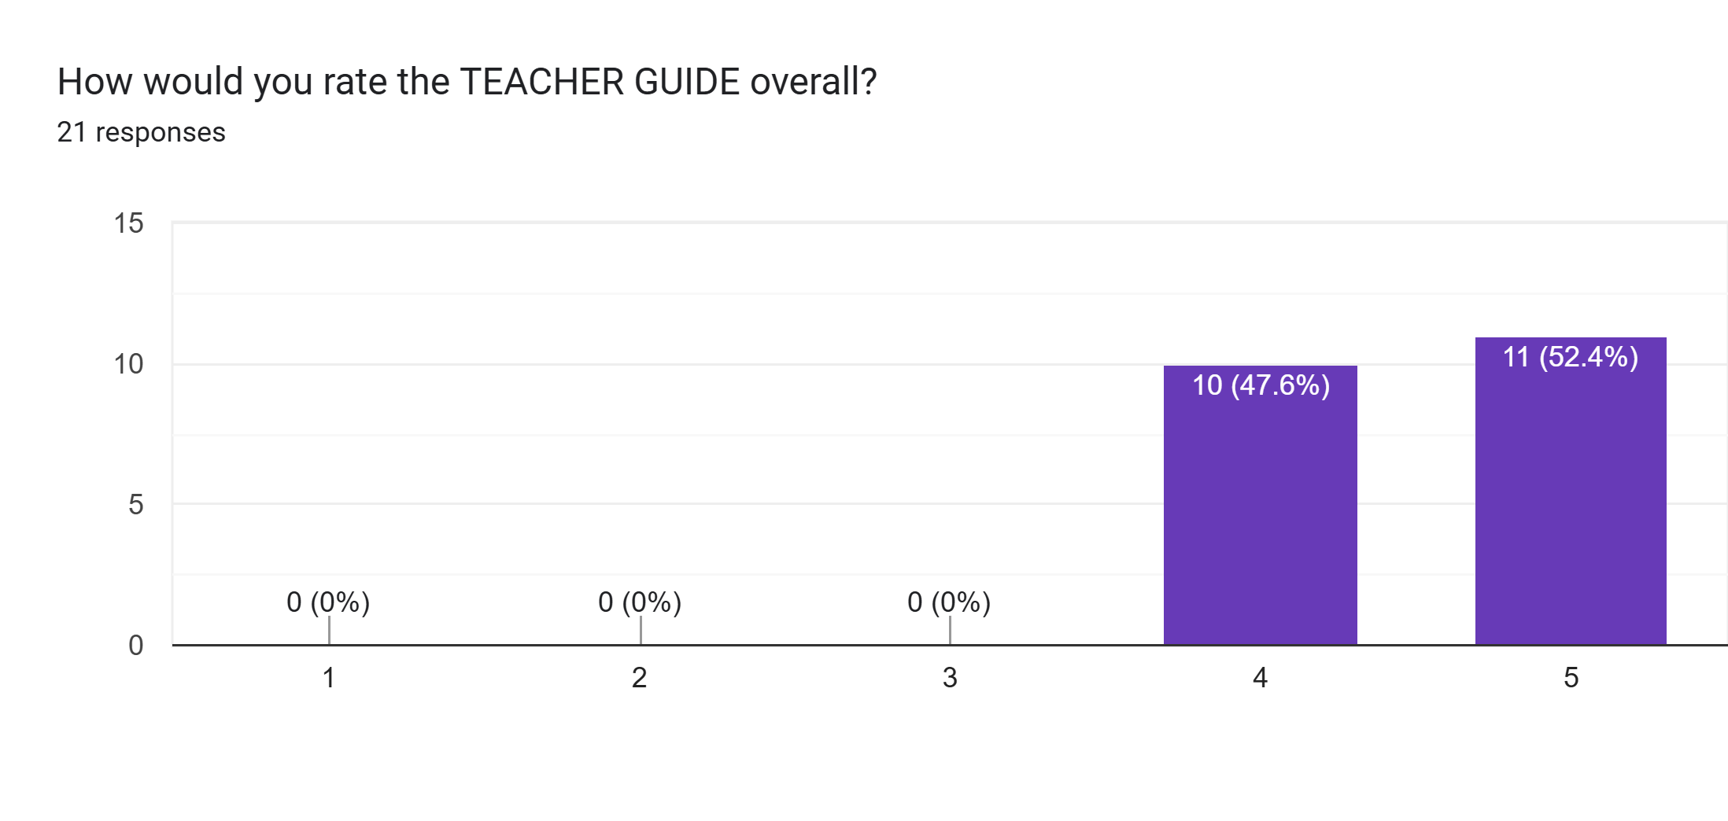
Teacher Guide
Number of Catechists responding to the question
Rating on a scale of 1-5, with 5 being the highest rating

Slide 21
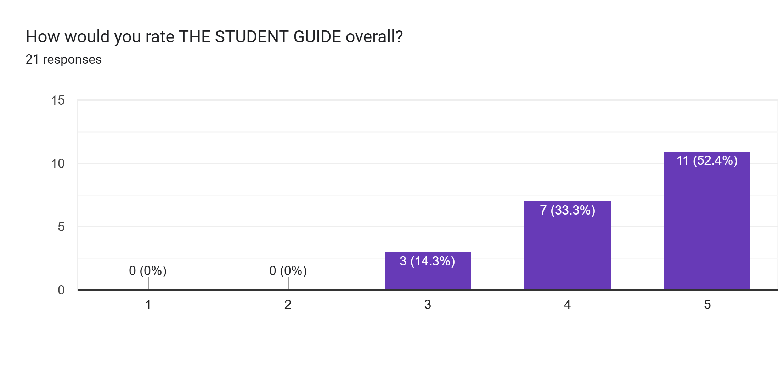
Student Guide
Number of Catechists responding to the question
Rating on a scale of 1-5, with 5 being the highest rating

Slide 22
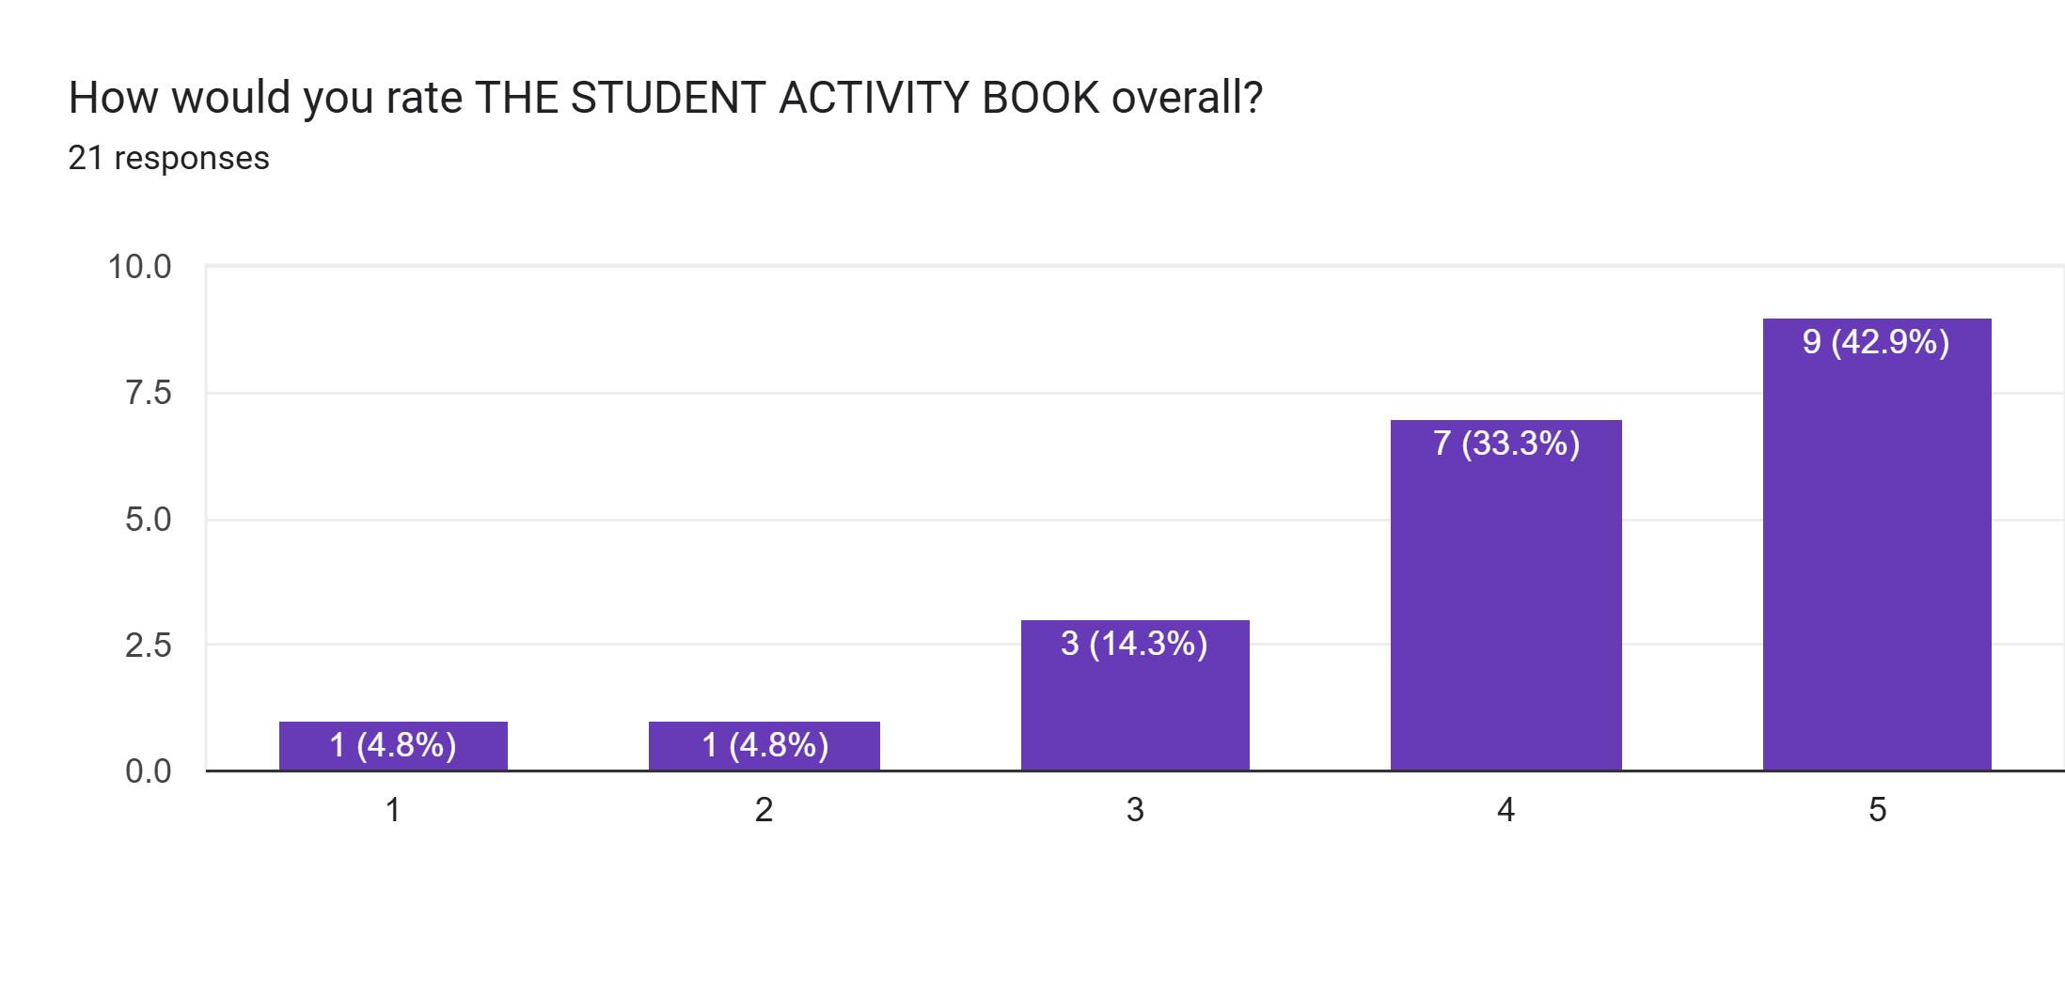
Student Activity Book
Number of Catechists responding to the question
Rating on a scale of 1-5, with 5 being the highest rating

Slide 23
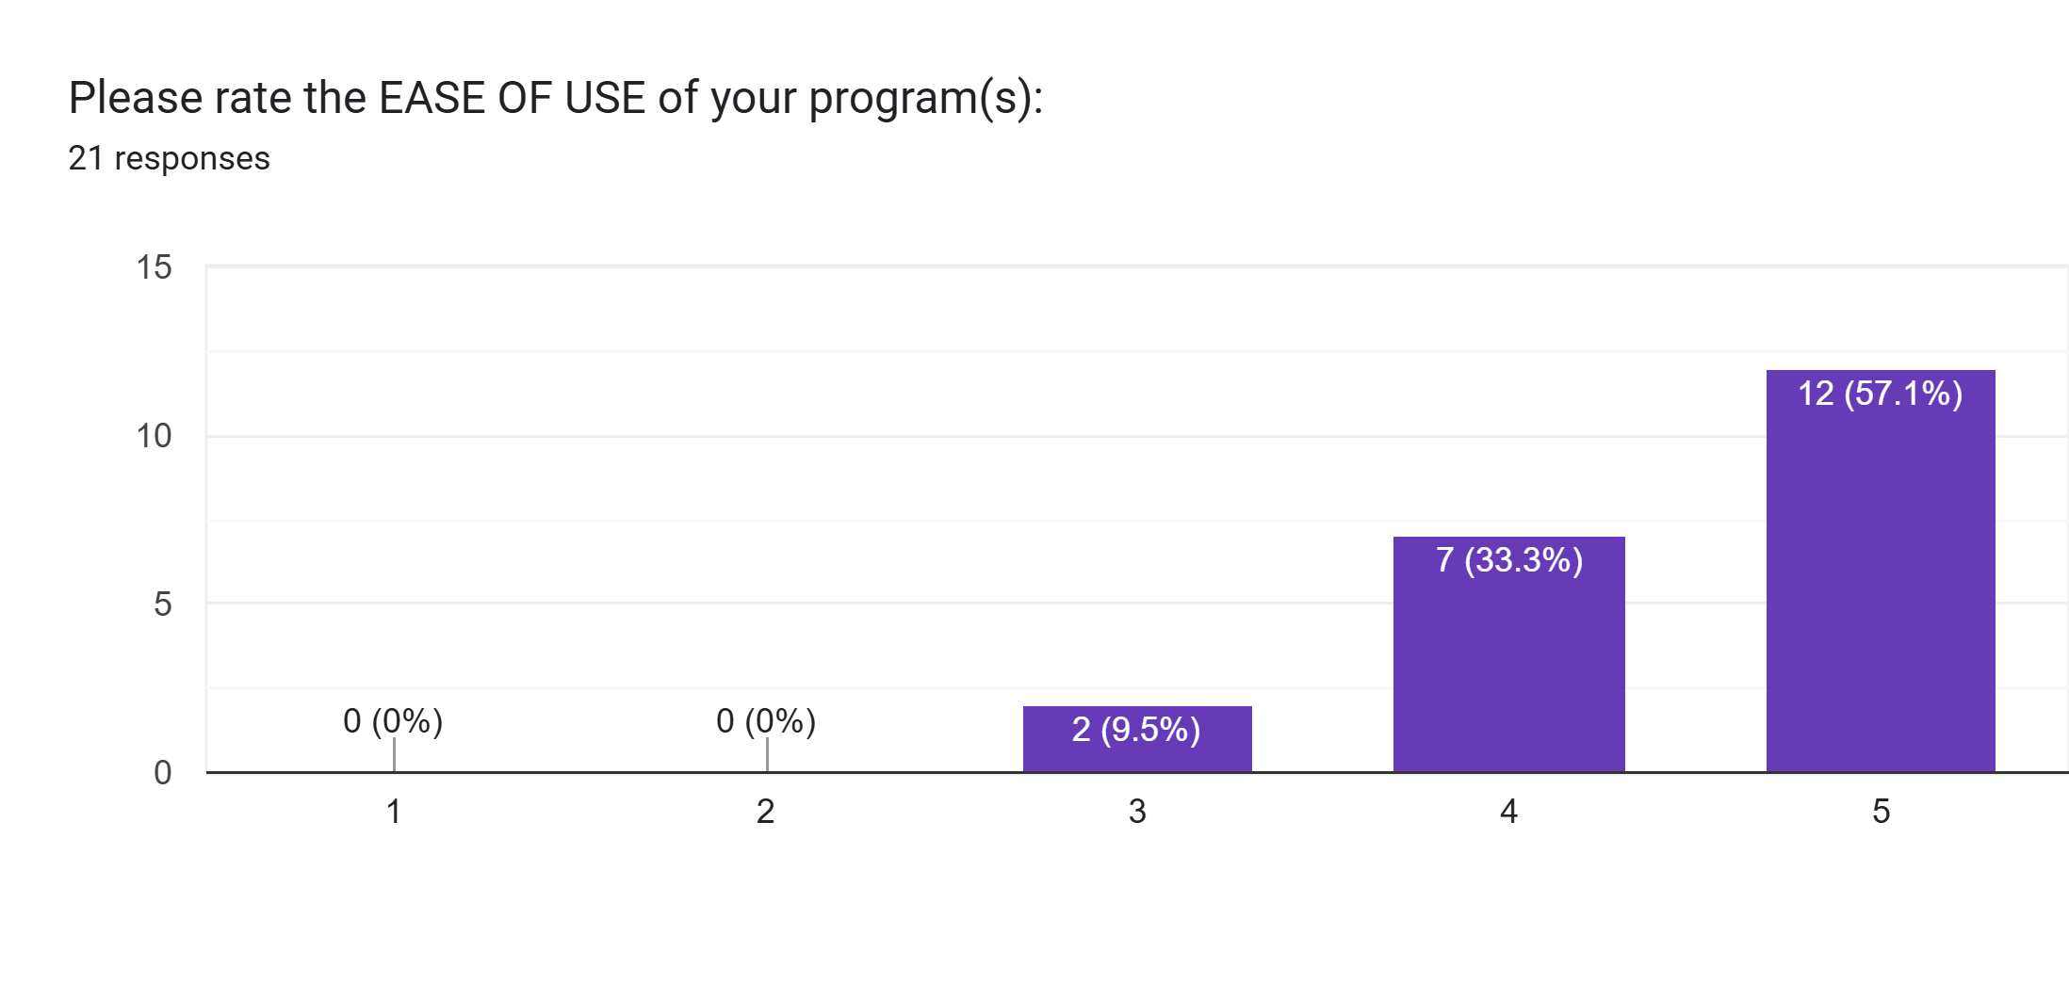
Ease of Use
Number of Catechists responding to the question
Rating on a scale of 1-5, with 5 being the highest rating

Slide 24
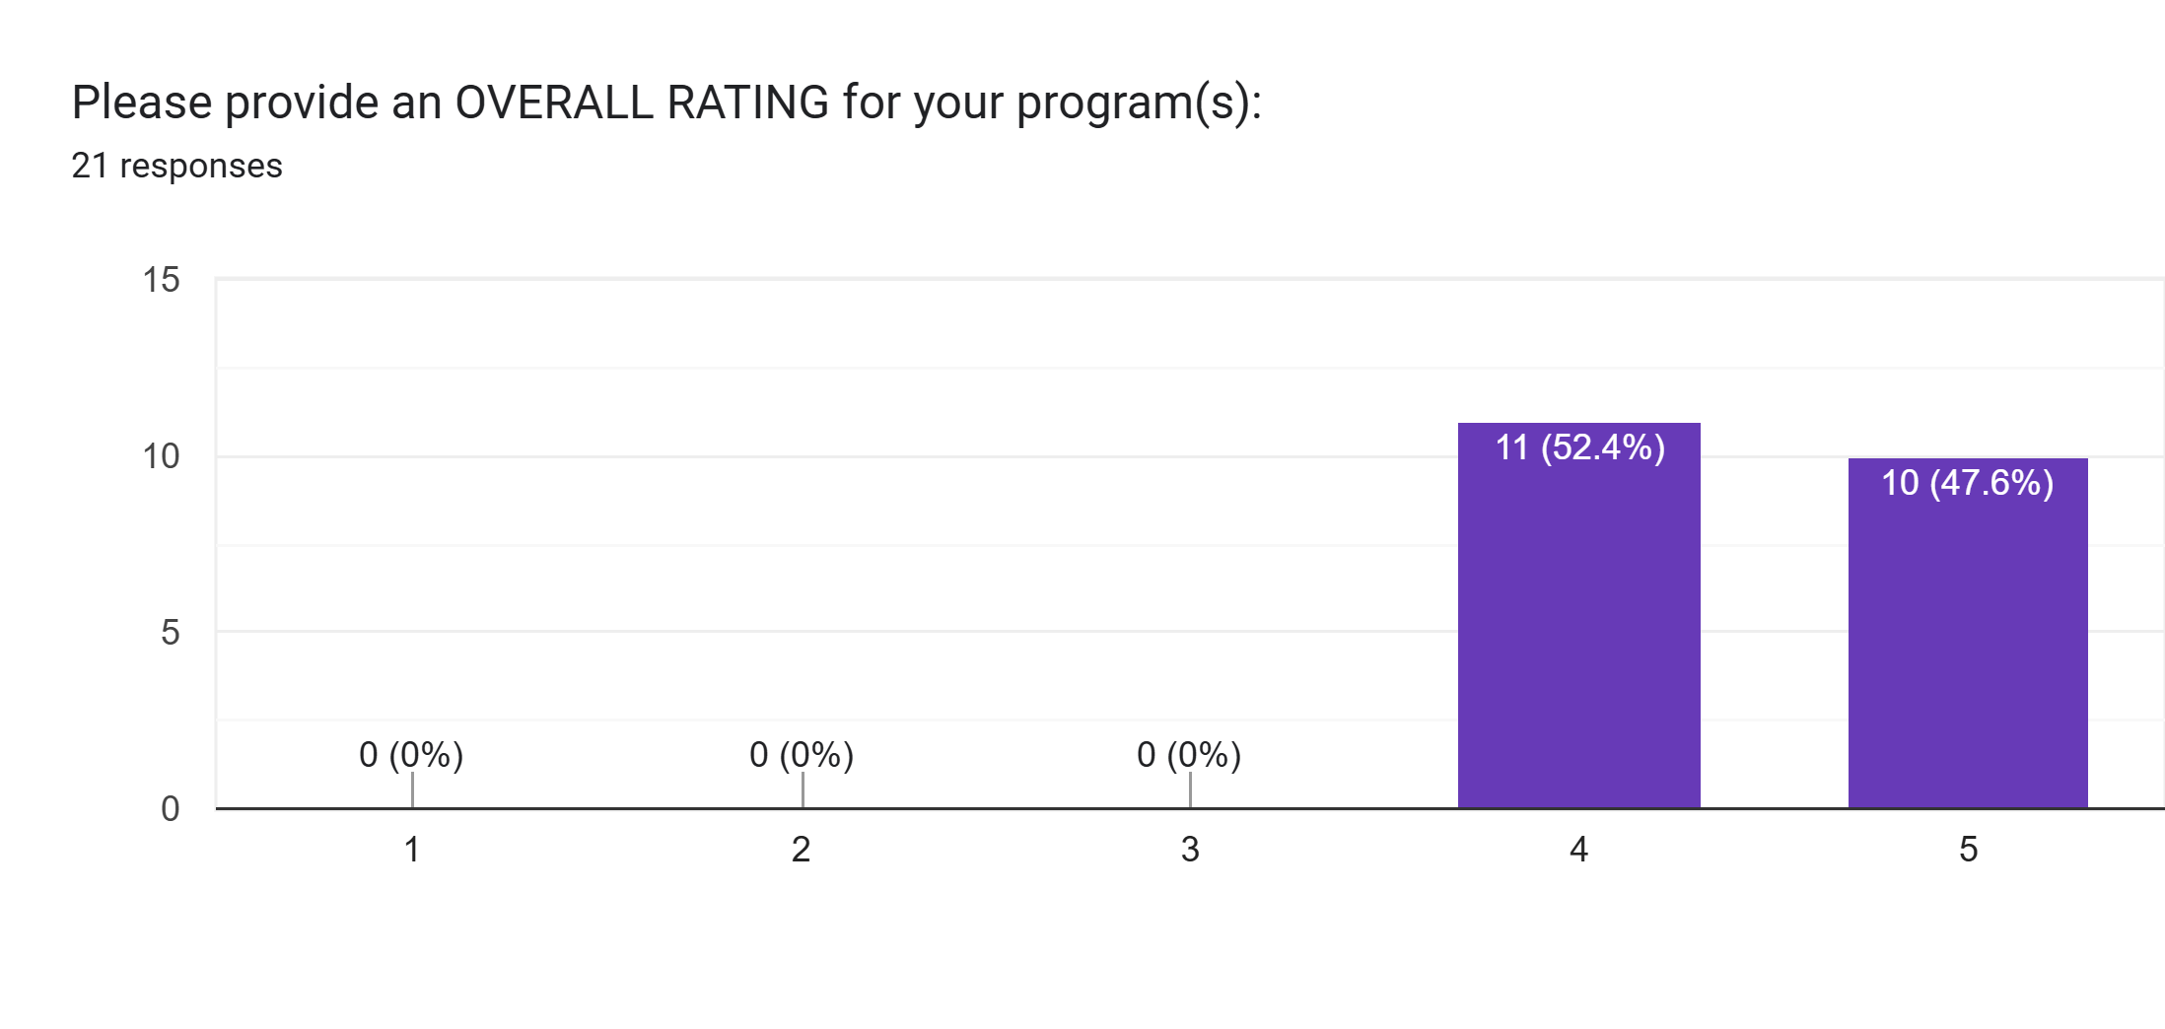
Overall Rating Score
Number of Catechists responding to the question
Rating on a scale of 1-5, with 5 being the highest rating

Slide 25
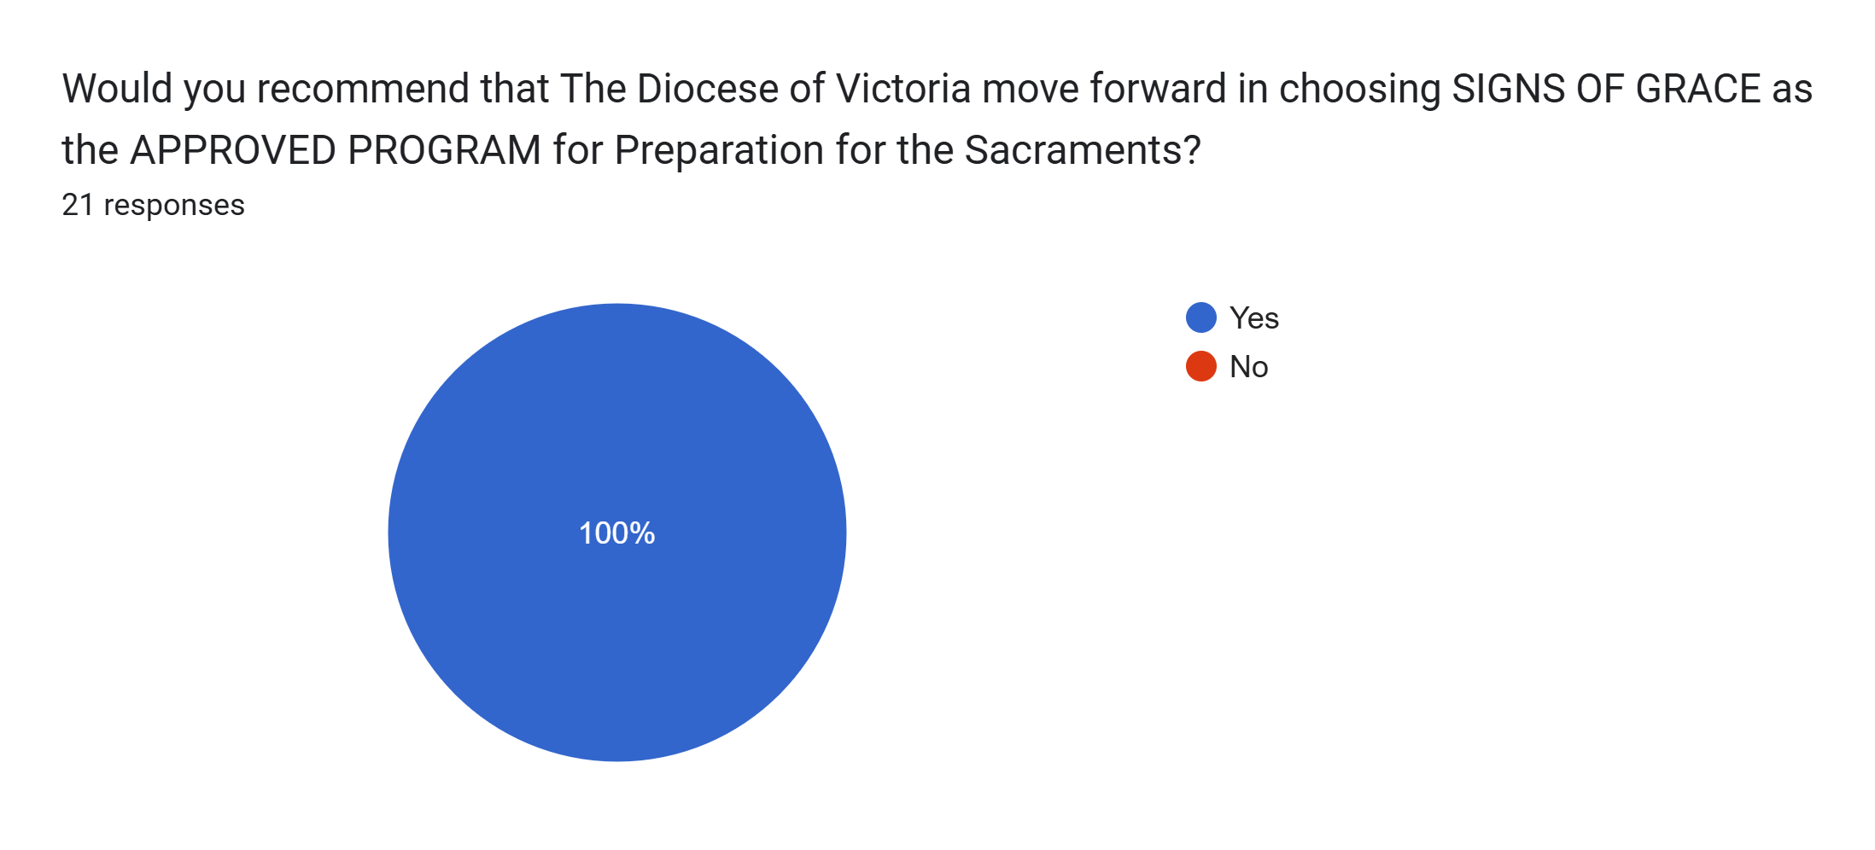
Signs of Grace as the Approved Program
for the Diocese of Victoria

Slide 26

Overall Rating
Signs of Grace Program
4.5 out of 5

Slide 27
Catechists’
Anecdotal Feedback/Comments
(Copied and Pasted from Survey)

Slide 28

Overall, I enjoyed using the Signs of Grace programs - I even learned a few things about our Catholic faith along the way!
Thank you very much for the opportunity to use this great material. It is such a blessing!
Content is kid friendly and easy to explain. The activities at home for the kids are engaging and help the family to participate. kids love the homework, I see them grow spiritually this year.

Slide 29
The Teacher Guide also effectively presents the material and will certainly support Catechists who may feel less knowledgeable about the content.
The format and structure options to adapt the class to various lengths is helpful. Overall the materials make it very easy to run a lesson and the teacher guide is helpful in preparing for the lesson. Very little teacher preparation time is required.
The videos are short, fun, informative. It keeps the children attention and deliver the necessary information successfully.

Slide 30
I think the program is perfect for the kids.
I pray that all parishes embrace the program so that all of us in the Diocese will use the program.
As a parent even I’m finding it quite interesting. Happy to be a part of this.
The videos are short, fun, informative. It keeps the children attention and deliver the necessary information successfully.

Slide 31
The Teachers Guide has helpful questions/answers to initiate conversation.
The content certainly includes the Catechism of the Catholic Church and is solid teaching of our faith. The discussion questions are very engaging and the group discussions have been very fruitful. I am wary about the retention rate of the material. Our older students demonstrate a much higher level of comprehension. I wish there was a greater emphasis on relationship with God but this program does a far better job than many that I have seen.

Slide 32
The Student Activity Book is wonderful. They are taken home for homework. What as an effective tool for reinforcing the material at home.
The Teacher Guide also effectively presents the material and will certainly support Catechists who may feel less knowledgeable about the content.
The Guides are very informative and appealing to children, written in simple language that is easy for them to understand and use

Slide 33
Content is good covers everything.
As a retired educator, the ease of use is fantastic. One of the only criticisms I have, is that there is an over abundance of “learning” That is good on one sense, but a newer Catechist might not know what to choose and focus on in each session.
Thank you for bringing Signs of Grace into the parishes.
Children are very happy with this program and they find it very interesting.

Slide 34
Cost of Program Implementation

Slide 35
Resources for Catechists/Parish: Option 1
Minimum Requirements:
One-Time Purchase for Catechists/Parish
Teacher Guide & DVD* Reconciliation = $61 + 35=$96+ tax & ship.
Teacher Guide & DVD* Confirmation = $61 + 35=$96+ tax & ship.
Teacher Guide & DVD* Holy Communion = $61 +35=$96+ tax & ship.
Total cost for 3 Teacher Guides and 3 DVDs
Approx. $350 CAD including tax & shipping
for Teacher Guides and DVD for all 3 Sacraments

Slide 36
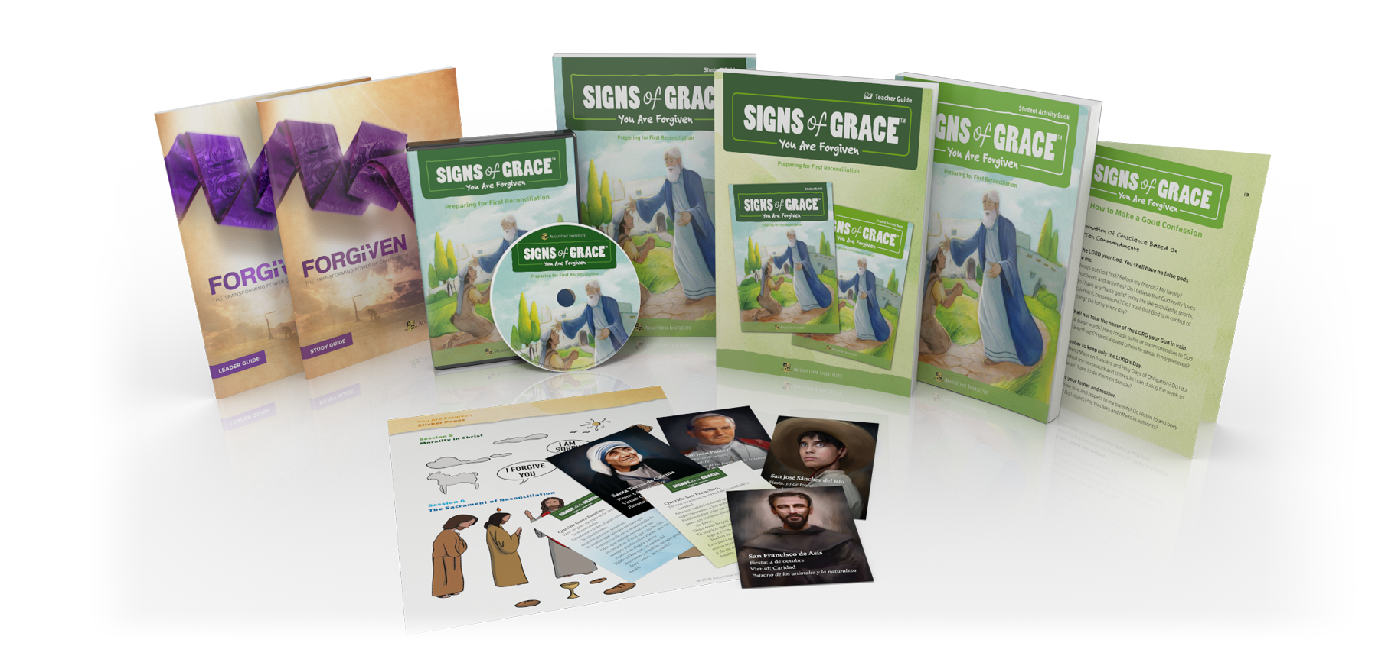
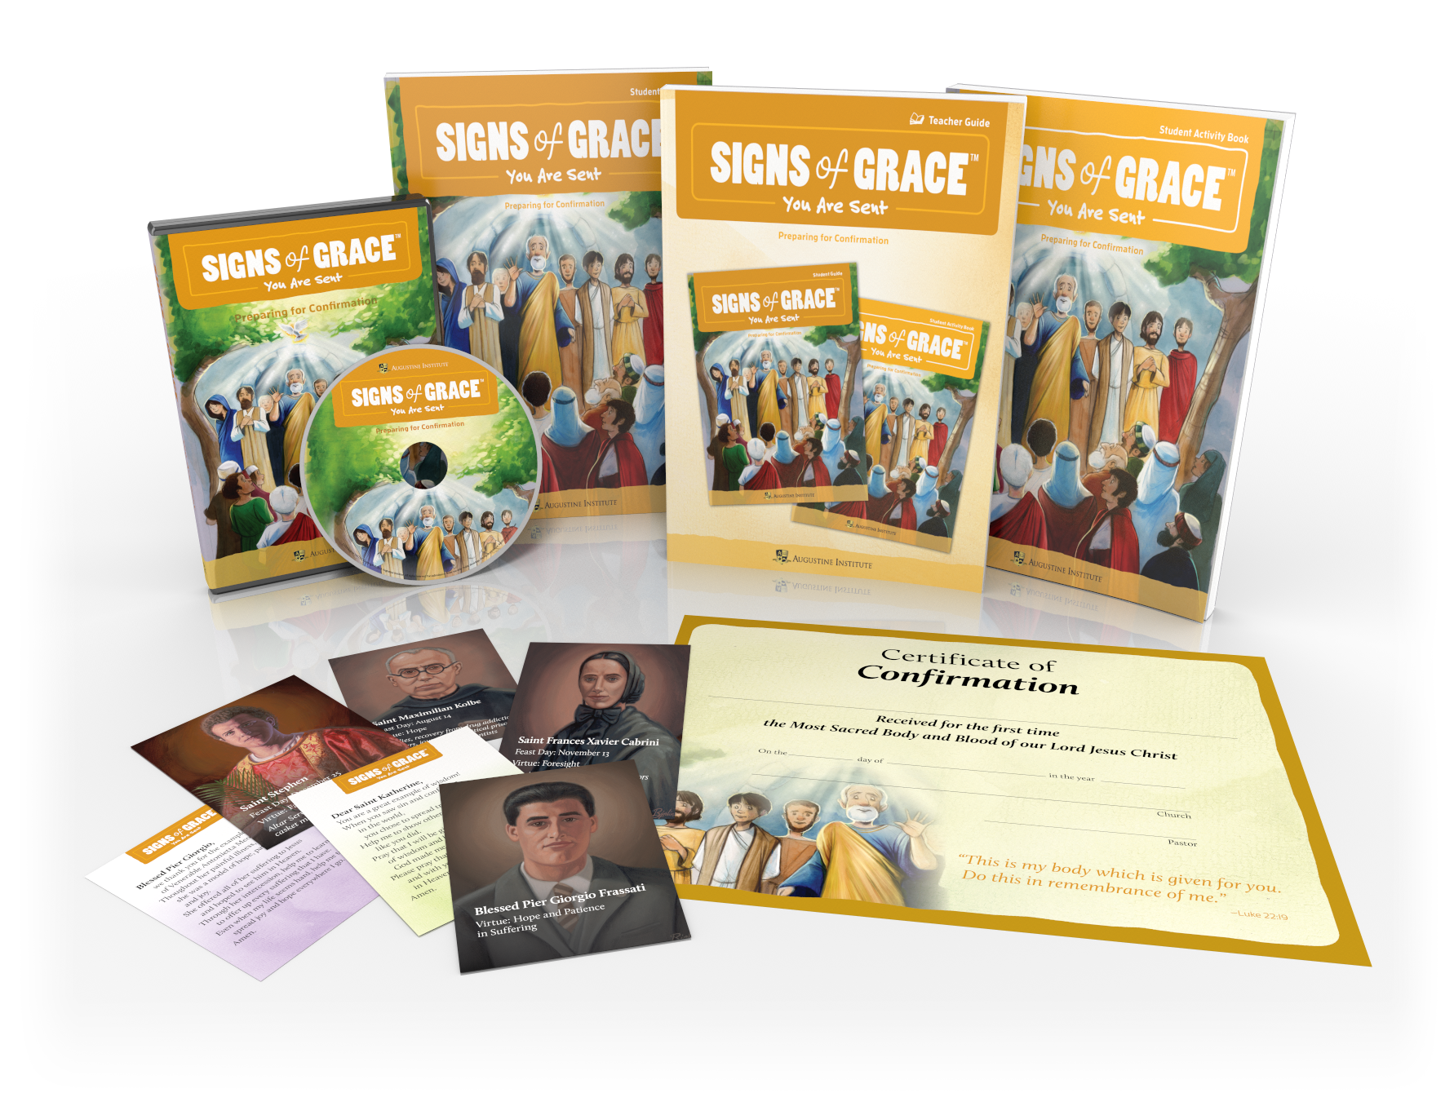
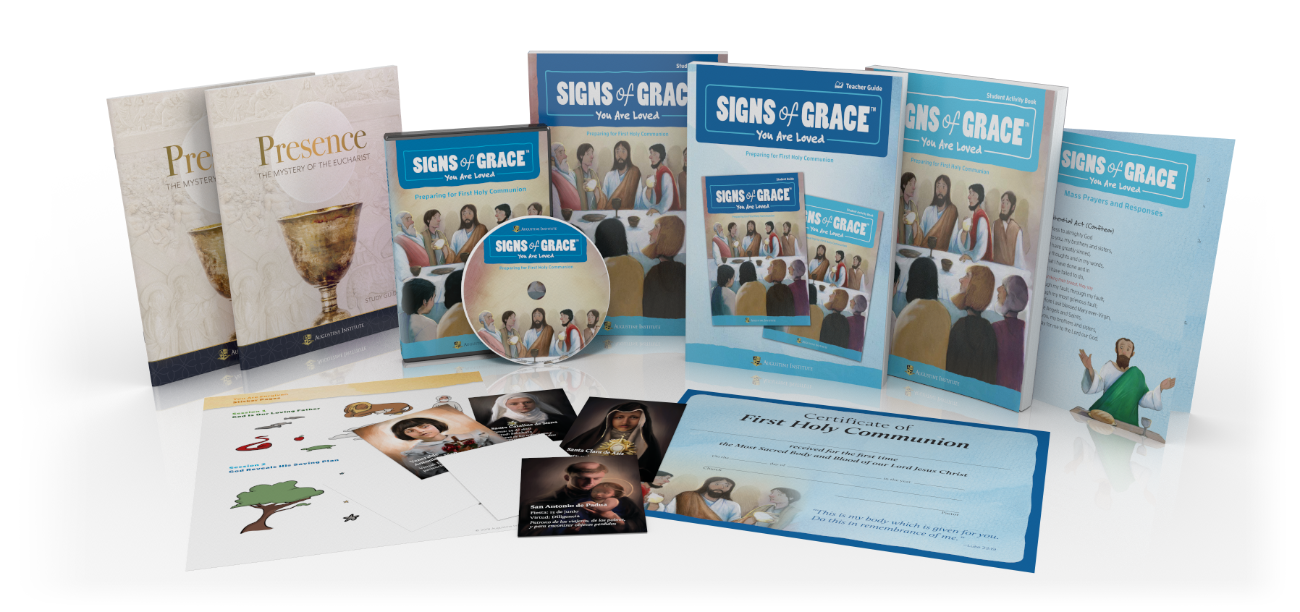
Resources for Catechists/Parish: Option 2
Deluxe Option: Some parishes may wish to purchase
3 Starter Kits including 3 Teacher Guides,
3 Student Guides, 3 Student Activity Books, 3 DVDs, and many extras including Saints Cards, Saints Booklets, Certificates…
$798 CAD tax and shipping included

Slide 37
Resources for Children
Student Guides and Student Activity Books
Annual Purchase
Most parishes already charge a small annual fee for materials for Sacramental Preparation
of approx. $35 per Sacrament
The Student Guide and Student Activity Book could therefore be covered by the annual fees charged to families
(see next slide)

Slide 38
Resources for Children
Student Guides and Student Activity Books
Annual Purchase
These costs can be covered by fees already collected annually from families.
Reconciliation:
Student Guide one per child = $18.77 CAD
Student Activity Book one per child = $12.34 CAD Total = $31.11+ tax + shipping per child
Confirmation:
Student Guide one per child = $18.77 CAD
Student Activity Book one per child = $12.34 CAD Total = $31.11+ tax + shipping per child
Holy Communion:
Student Guide Holy Communion = $18.77 CAD
Student Activity Book one per child = $12.34 CAD Total = $31.11+ tax + shipping per child

Slide 39
Kindly direct questions or concerns to
Joelle Dressler
jdressler@rcdvictoria.org
250 479 1331 ext 230

